Slide 1

Final Project
GROUP # 7

Slide 2
Ambulance Patient Offload Times (APOT) for the County of Sacramento
Ambulance Patient Offload Times or APOT are wait times experienced by patients taken to an ER via ambulance. The wait is caused by lack of bed to move the patient into and at times lack of staff to care for the patient. Our goal centered in identifying what is influences the extended wait times. Shedding a light on where the problems are will show the parties involved where to look and help initiate a plan to alleviate the current situation.
Questions we hope to answer:
Which impressions have the longest/shortest APOTs? (Overall and by Hospital codes)
Compare to Postal Codes. Which Postal Code areas experience the highest/lowest APOT times when taken to the hospital via ambulance ?
Which zip codes utilize ambulance transports to the ER the most in 2017-2022?
Wait times per hospital by date/time
Do any patterns arise from the data?

Slide 3

Data Sources
The data selected for this project was obtained from Sacramento County Emergency Medical Services Agency. The data set includes the following data points :
Destination Hospital Identifier
Destination Hospital Location (Latitude & Longitude)
Date/Time of Occurrence
Ambulance Patient Offload Time (APOT)
Patient Complaint Identifier
Ambulance Agency Identifier
Ambulance Unit Identifier
Postal Code of Location where call Originated

Slide 4


Slide 5
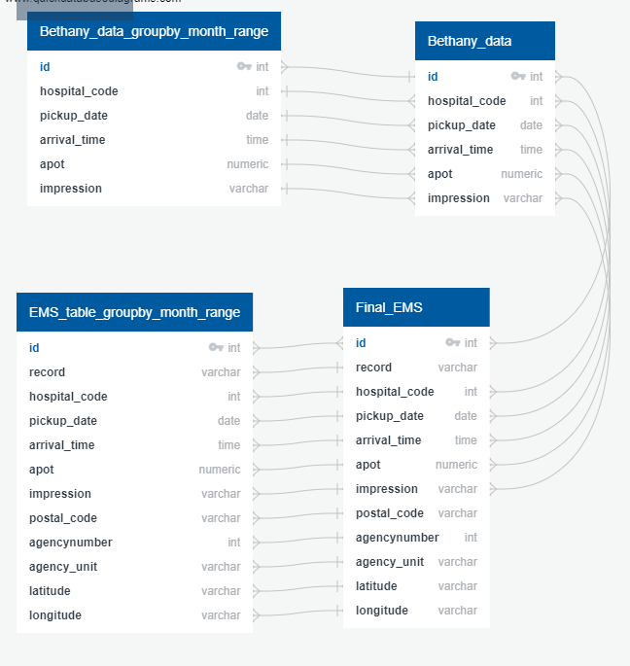
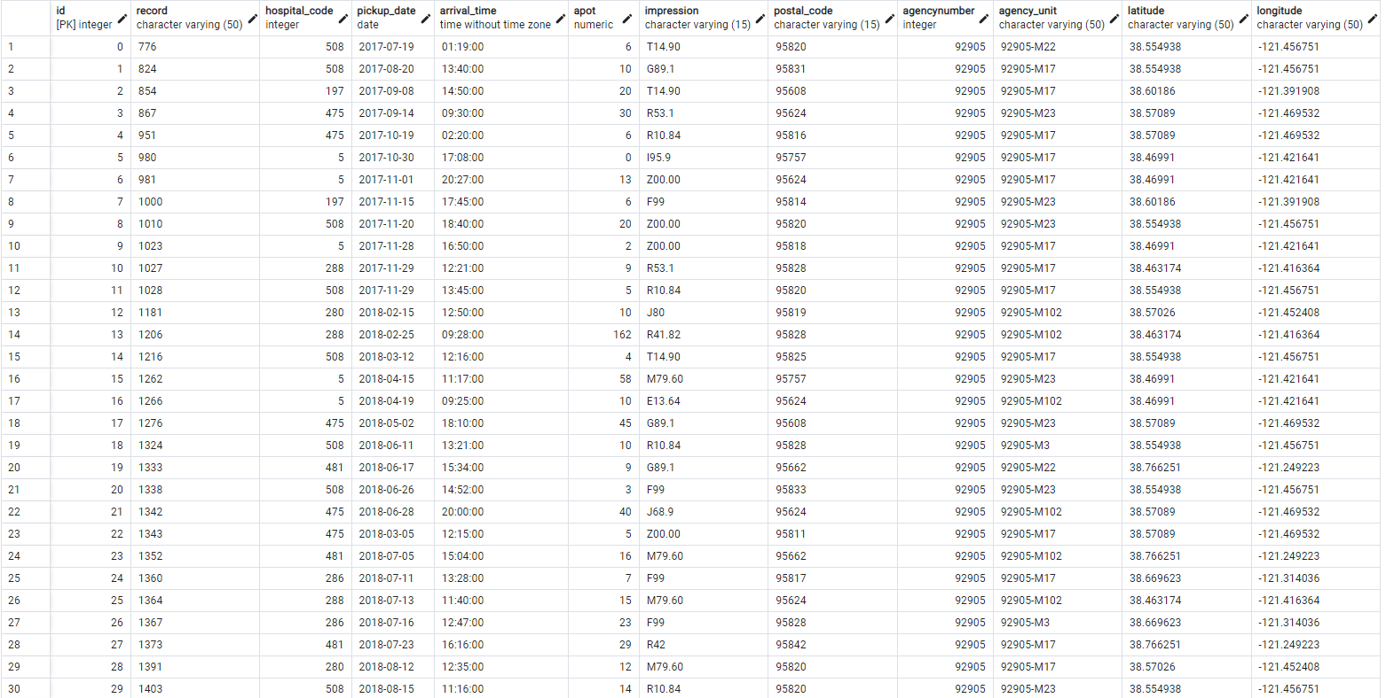
PGAdmin was used as the main Database
ERD DIAGRAM
EXAMPLE OF TABLES

Slide 6
Machine Learning
SciKit-Learn is the selected Machine Learning Module that will be used during this project. The hosting platform will be utilized on Github. Models and Strategies used include the following:
Linear Regression
Balanced Random Forest Classifier
Easy Ensemble AdaBoost Classifier
Oversampling
SMOTE Oversampling
Undersampling
Combination (Over and Under) Sampling

Slide 7
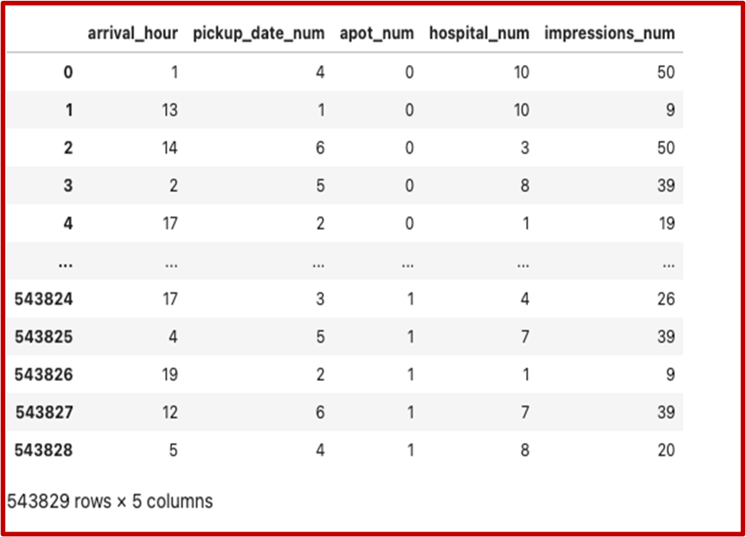
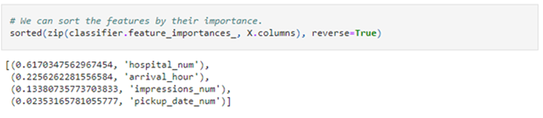
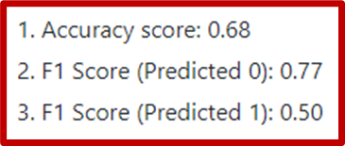
Description of feature engineering and the feature selection, including the decision-making process
Initially, it was thought that by using the label_encoder function on all of the columns that could not be easily converted into an integer, due to having mixed data types.
It was found that this was just resulting in large ranges of numbers that separated the rest of the data points so much that it looked as though there was no correlation between any of the columns in the dataset
The Balanced Random Forest Classifier model provided a lot of insight into the feature importances of our data and proved to be invaluable because of that, it didn’t ultimately provide the best results
Through machine learning we were able to identify that the time of day and hospital destination has the greatest influence to Ambulance Patient Offload Times

Slide 8
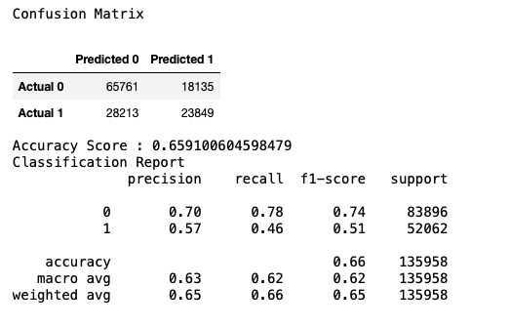
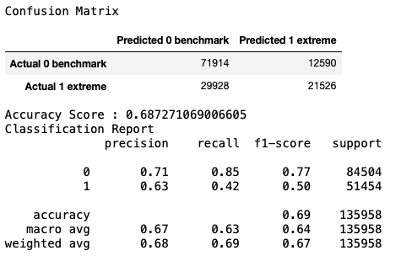
Model Comparison Results
Random Forest
Gradient Booster

Slide 9


